Slide 1
Deploying a Java Application Using on a Tomcat Server Using Maven , Jenkins and AWS
-Manne Niteesh Chandra

Slide 2
Contents
Introduction
Diagram
Working

Slide 3
Introduction
Jenkins:
Jenkins is a tool that is used for automation, and it is an open-source server that allows all the developers to build, test and deploy software. It works or runs on java as it is written in java. By using Jenkins we can make a continuous integration of projects(jobs) or end-to-endpoint automation

Slide 4
Maven:
Apache Maven is a software project management and comprehension tool. Based on the concept of a project object model (POM), Maven can manage a project's build, reporting and documentation from a central piece of information.
Tomcat:
Apache Tomcat is a web server and servelet container that's used to deploy and serve Java web applications

Slide 5
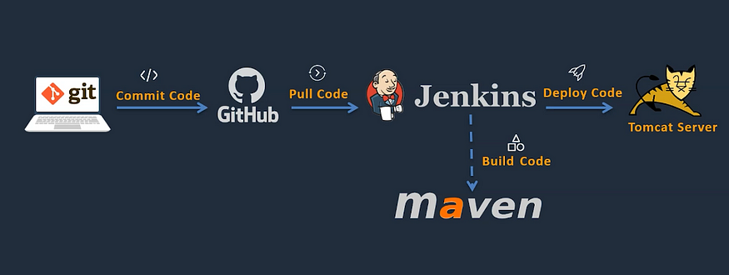
Diagram

Slide 6
Working:
Create two EC2 instances one for master and other one is for slave.
Install Jenkins software in Master instance and open Jenkins in browser by copying the IP address of the instance
Install Java, maven, tomcat in the slave instance and edit some changes in Tomcat files(content.xml, server.xml, tomcat-user.xml) and assign required port number for maven in security group of the instance
You can check it by copying the ipv4 address of the slave and paste it in browser
Install maven integration, deploy to container plugins in java browser

Slide 7
Now connect slave and master
Deploy a job in the slave
You can check whether the job is successful or not in console output and in the instance you can see it workspace
You can also check it in Tomcat Server

Slide 8
Thank you

